Slide 1


Ayshah, Antonino, Sheraz

Slide 2

User need story
As a user, I want to search for books based on their title, author, or genre So that I can read others reviews and ratings and leave my own reviews.
Our project meets this user need since when a book is searched for its cover is displayed and it displays to the user reviews that have been left and also the average rating for that book. Users can also leave their own review on a book- once the review has been posted, it can be edited or deleted. The logo is a play on words hence the bee theme.

Slide 3
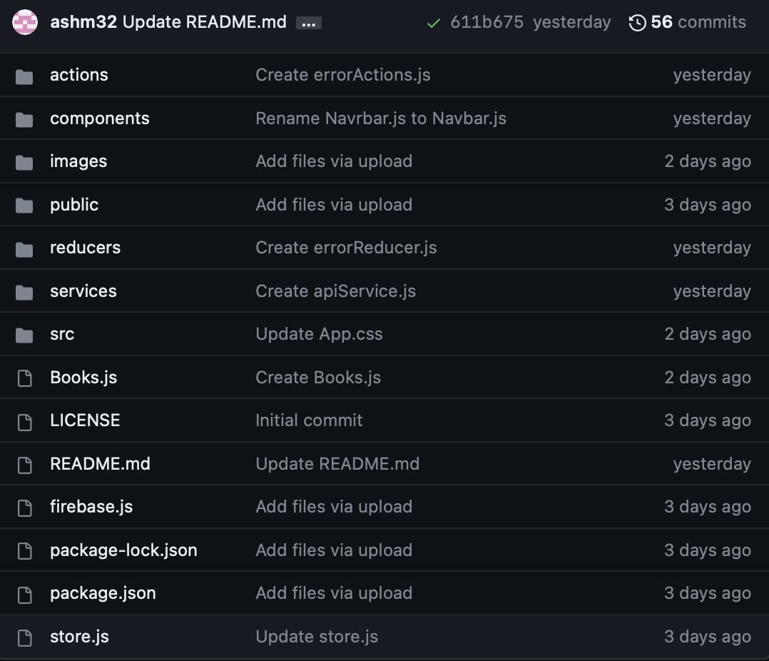
Code: Structure overview
src: This contains subfolders and files related to different aspects of our application.
src/components: This folder holds the individual components of our React application.
src/actions: This folder contains action files that define the actions available in our Redux application. Actions are the functions that describe events or user interactions that can occur in our application and trigger changes in the state.
src/reducers: This folder holds the reducer files, which specify how the application's state changes in response to different actions. Reducers take the current state as input and return a new state.
store.js: This combines the reducers and creates the Redux store.
src/services: This folder contains service files or modules that handle specific functionalities or external service integrations, such as API requests, authentication, storage, or analytics.
public: This folder contains static assets and the HTML file (index.html) that serves as the entry point for our application.
package.json: This file includes data about the project, as well as the list of dependencies and scripts required for building, running, and testing the application.

Slide 4
What were the technologies used?
HTML
CSS
JavaScript
React.
Use Node.js
API
both GET and POST routes for retrieving and adding new data.

Slide 5
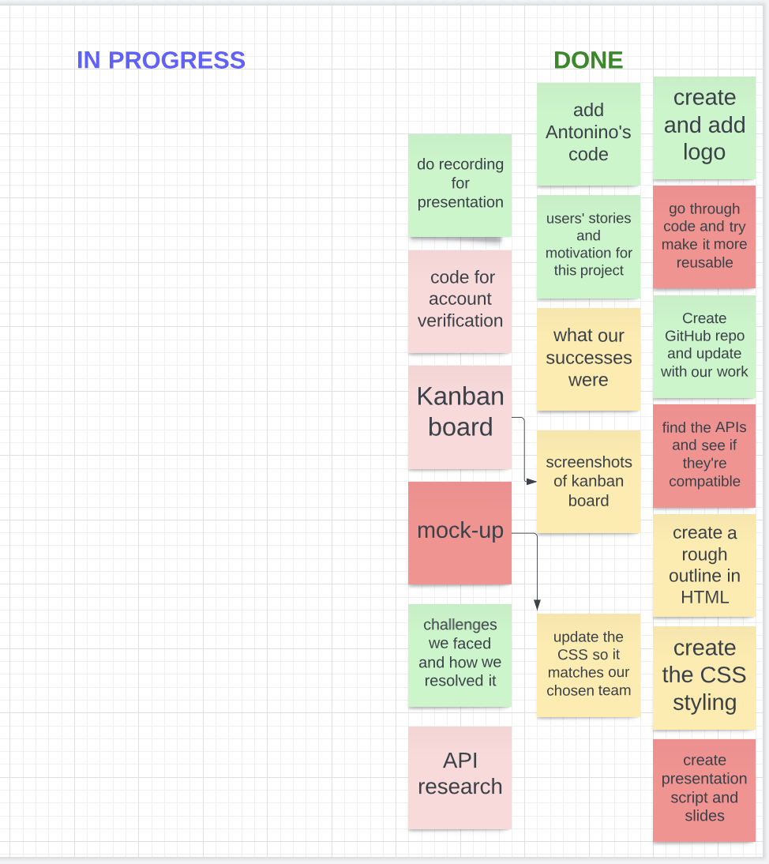
How were tasks and group roles broken down and assigned?
- Slack team channel
- Kanban board
- Tasks assigned to each team member to execute

Slide 6
What challenges did you encounter?
Find free available APIs
Ensure that the GitHub repository was cloned correctly and commits sent correctly
Make the application work in all of the team member’s machines
Time management and brainstorm and develop a project is such a short amount of time

Slide 7

What were your successes?
We worked on something which was agreed by all team members
The creation of an application involving all of the skills learnt throughout the BootCamp
Managing the GitHub repository in a correct way and learning how to clone successfully
The development of a presentation clear for the audience

Slide 8
Showing you bookbuzz!
GitHub repository: https://github.com/ashm32/bookbuzz
REACT URL: http://192.168.1.173:3000

Slide 9

Directions for future development
Ensure that the code works in all machines after cloning

